Slide 1
Image Super RESOLUTION USING SRcnn Group members: Yusha arif: 18K 1289 Mugheera Bin sadiq: 18K-0296 Abdurraffay 18k-116

Slide 2
Introduction
The problem here is the recovering of high-resolution image from a single low-resolution image. The motivation behind the implementation of this project is to help students who can’t afford smartphones with high resolution camera and the image capturing of class boards is an important resource for a student as they can preserve the work for future use. Due to low-resolution image, they can’t use the image in future as they can’t see the work properly so this model will help these students to map there low-resolution image to high resolution image.

Slide 3
DESIGN
A feed forward CNN with 3 layers
Patch extraction and representation (Layer1)
filter size = 9
F1(Y) = max (0, W1 ∗ Y + B1)
Non-linear mapping (Layer2)
filter size = 5
F2(Y) = max (0, W2 ∗ F1(Y) + B2).
Reconstruction (Layer 3)
filter size = 5
F(Y) = W3 ∗ F2(Y) + B3
Activation Function: ReLU : max(0,x)
where W1, W2, W3 are weights of filters and B1, B2, B3 are bias.

Slide 4
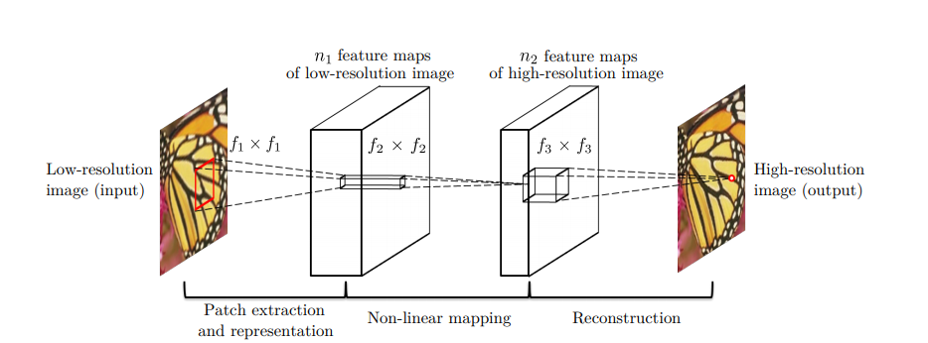
Architecture

Slide 5
methodology
The dataset we used for training was the STL10 dataset. This dataset has the following features:
10 classes: airplane, bird, car, cat, deer, dog, horse, monkey, ship, truck.
Images are 96x96 pixels, color.
500 training images (10 pre-defined folds), 800 test images per class.
For testing, we used the Set14 dataset which is a dataset consisting of 14 images commonly used for testing performance of Image Super-Resolution models
The work was divided equally amongst the group members. Yusha was responsible for defining the architecture of the SRCNN model and creating the training module. Abduraffay worked on the evaluation module whereas Mugheera was responsible for extracting the key information from the research papers and setting up the tensorboard for displaying the training results.

Slide 6
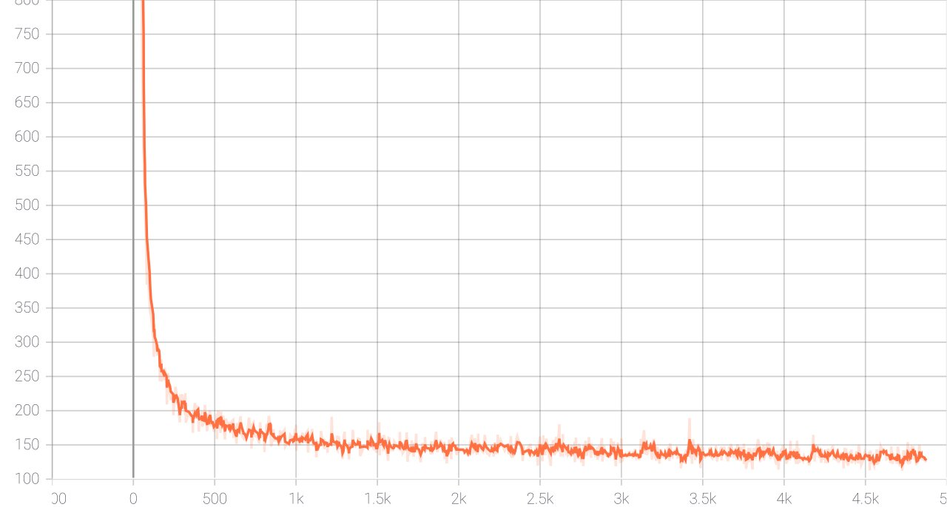
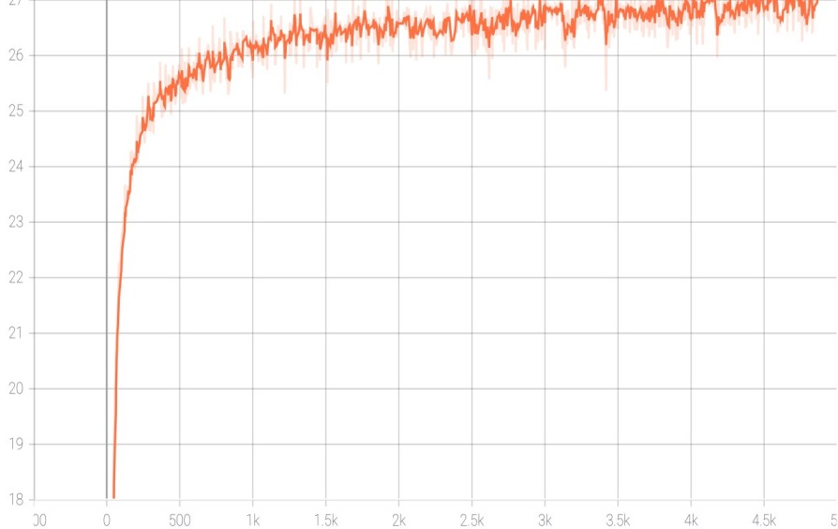
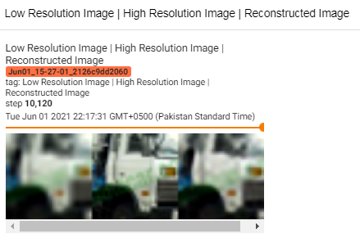
results
MSE
PSNR of BiCubic Interpolation

Slide 7
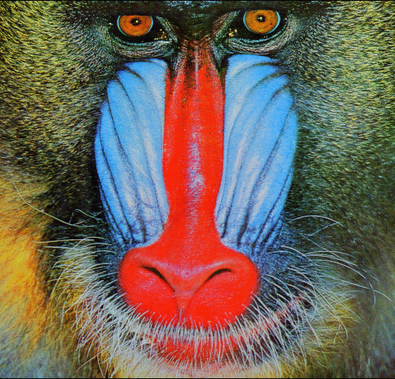

ReSULTS (cont)

Slide 8
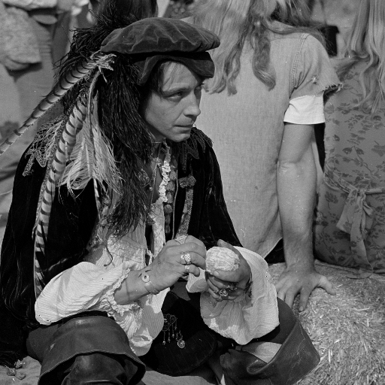
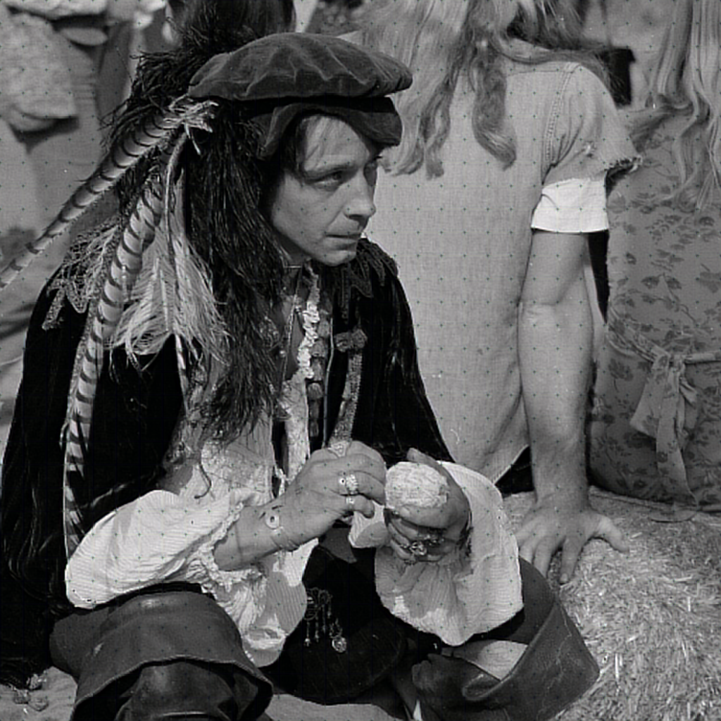
RESULTS (Cont)

Slide 9
Conclusion and future work
The accuracy of the model will improve more when it will be trained on much larger dataset and much greater values of epoch size. In addition to these measures the performance of this model can also improve by exploring more filters and different training strategies. The model can be extended to use in real life applications like installing this model in the surveillance cameras used in traffic signals to help the traffic police in monitoring the vehicle speeds and recognizing the vehicles which are over-speeding and due to this over-speeding, the images captured by the cameras are not good enough to recognize so these images can be mapped to high resolution images.

